Slide 1

Flame and Smoke Detector Sensor Network Lab (mini project)
by
Rahul A. Sajekar (Roll No.33)
Siddhant S. Singh (Roll No.36)
Ashutosh S. Tiwari (Roll No.40)
Under the Supervision of
Prof.H.M.Hatwar
Department Of Information Technology
Konkan Gyanpeeth College Of Engineering, Karjat 410201
University Of Mumbai
(2018-19)

Slide 2
Introduction
In recent years, fire detection has become a very big issue, as it has caused severe damage including the loss of human lives.
Early detection of a fire is an effective way to save lives and reduce property damage.
We have designed an sensor based Flame and Smoke Detector System which will raise an alarm when there is presence of Fire and send related information to the ThingSpeak from where user can monitor sensor remotely.

Slide 3
Literature Survey
Sr.No | Title | Author | Description
1. | Fire Sensing Technologies: A Review | Anshul Gaur, Abhishek Singh, Ashok Kumar, Kishor S. Kulkarni, Sayantani Lala, Kamal Kapoor, Vishal Srivastava, | The review presents an overview of the existing stateof-the-art practices in the area of fire sensing and control system and it is focused mainly on the excellent capability to detect fire, reduce the detection of false positives, the ability to notify the occupants, passes the information and status of the fires to the fire department, and automatic control capability of the occupants’ safety and controlling functions.
2. | Validation of Active Fire Detection From Moderate-Resolution Satellite Sensors | Ivan A. Csiszar, Jeffrey T. Morisette, and Louis Giglio | This paper discusses the process of validating active fire “yes/no” binary fire detection products from moderateresolution satellite sensors.
3. | Autonomous Fire-Detection System Using Adaptive Sensory Fusion for Intelligent Security Robot | Ren C. Luo and Kuo L. Su | This paper proposes an adaptive fusion algorithm for fire detection, and uses a smoke sensor, flame sensor, and temperature sensor to detect fire incident.
4. | Hardware Design and Web-based Communication Modules of a Real-time MultiSensor Fire Detection and Notification System using Fuzzy Logic | Robert A. Sowah, Abdul R. Ofoli , Selase Krakani, Seth Fiawoo | This paper presents the design and development of a fuzzy logic based multi-sensor fire detection system and a web-based notification system.

Slide 4
Applicability
The flame and smoke detectors are applicable in Homes, Malls, Industries, Residential complexes, Parking areas, Office areas, etc.

Slide 5
Software and Hardware Requirements
Software:
Arduino IDE .
Hardware:
nodeMCU.
Smoke sensor(MQ2).
Flame sensor.
Buzzer.

Slide 6
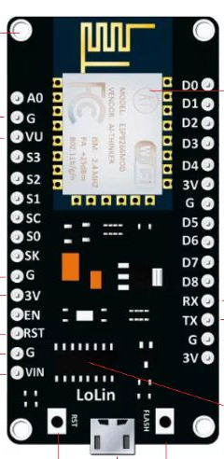
nodeMCU :
Features :
Operating Voltage : 3-3.6 V.
Operating System :XTOS.
Programmable WiFi Module
10 GPIOs D0-D9, PWM functionality
RAM : 128 KB.
ROM : 4 MB
IIC and SPI communication

Slide 7

Smoke Semsor (MQ2) :
Features :
Wide range sensitivity to
combustile gas.
Low cost and better life.
Sensor type : Semiconductor.
Drive circuit is simple.
Concentration : 300-10000ppm
( Combustible gas)
Supply voltage : 5V
Better sensitivity to Propane,LPG and
Hydrogen

Slide 8

Flame Sensor :
Features :
LM393 comparator chip.
Detection Range : 760 nm to 1100 nm.
Operating Voltage : 3.3 V to 5 V
Digital Outputs : 0 and 1.
Detection Angle : about 60 degrees.

Slide 9
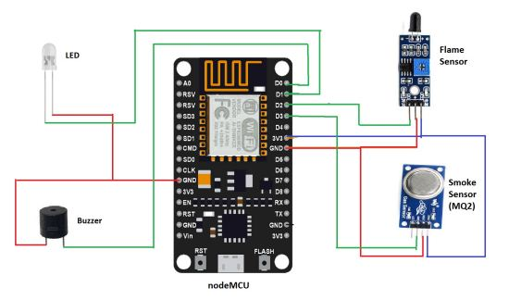
Circuit Diagram :

Slide 10
Flowchart

Slide 11
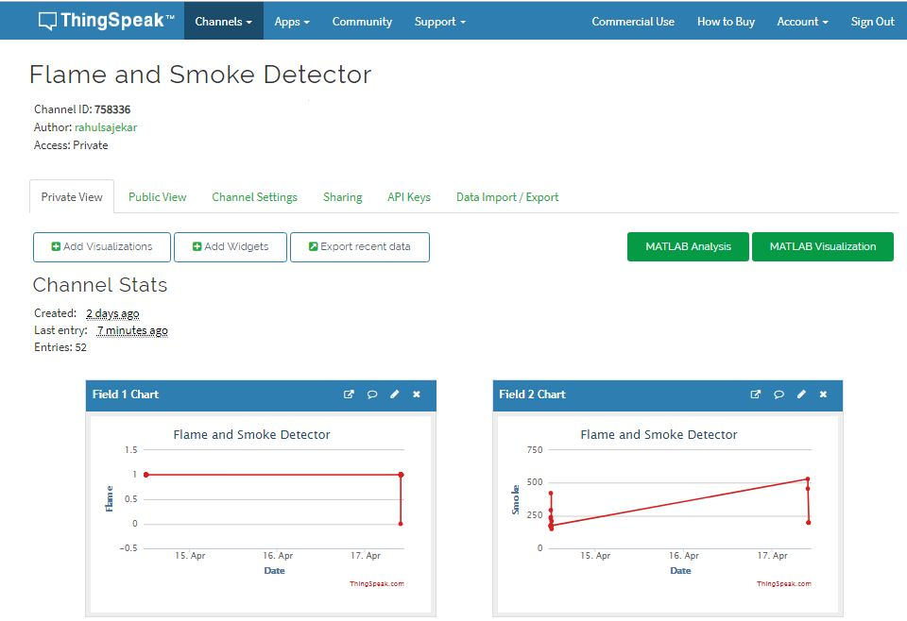
Data Uploaded to ThingSpeak :

Slide 12
Future Scope
In future we can add the notification functionality which can notify the user whenever there is flame or smoke is detected.
We can also add the Water Sprinkler that automatically turn on after detection of flame or smoke.We can control the water sprinler remotely .

Slide 13
Thank You

